Slide 1
New Facilities, Same Excellent Staff

Slide 2
Rehab has moved!
Good Samaritan Rehab has moved to a new location.
We now offer new facilities boasting:
First-rate, private, attractive rooms
Top of the line therapy and gym equipment
Attentive and friendly nursing staff
Image Here – Remove box and replace with image

Slide 3
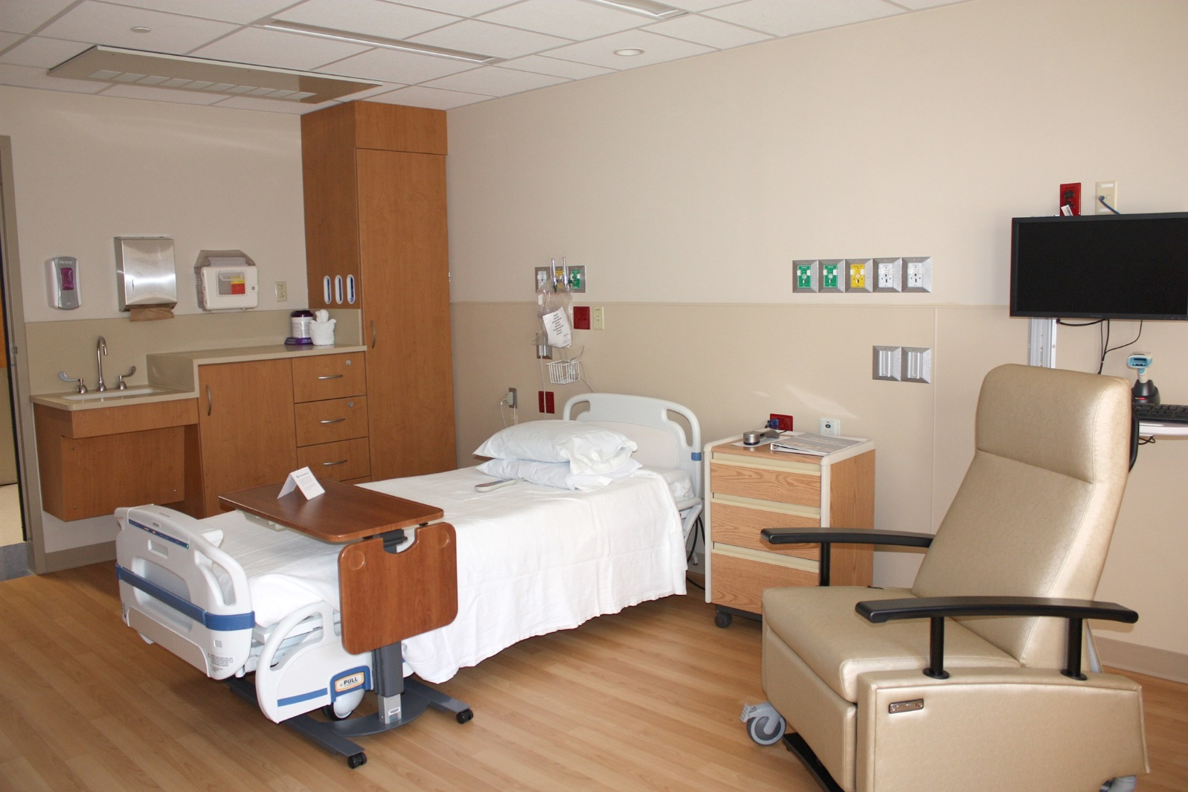
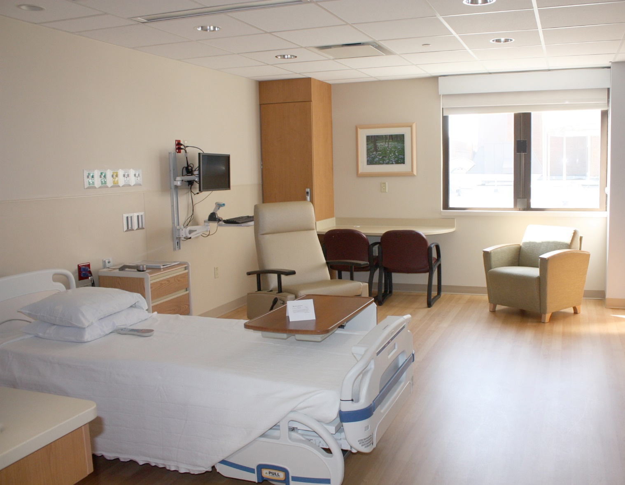
Housing
New and comfortable rooms offer privacy and comfort during your stay.
Image Here – Remove box and replace with image

Slide 4
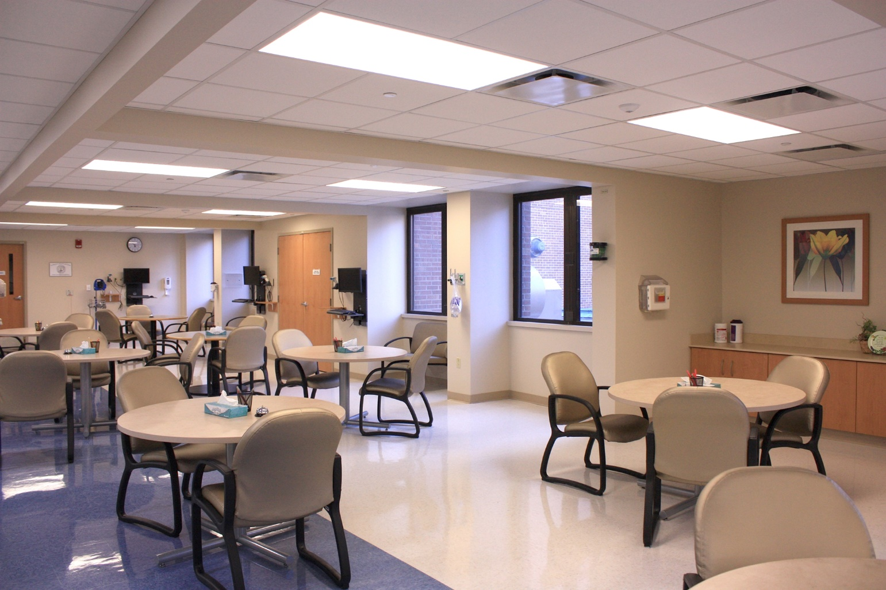
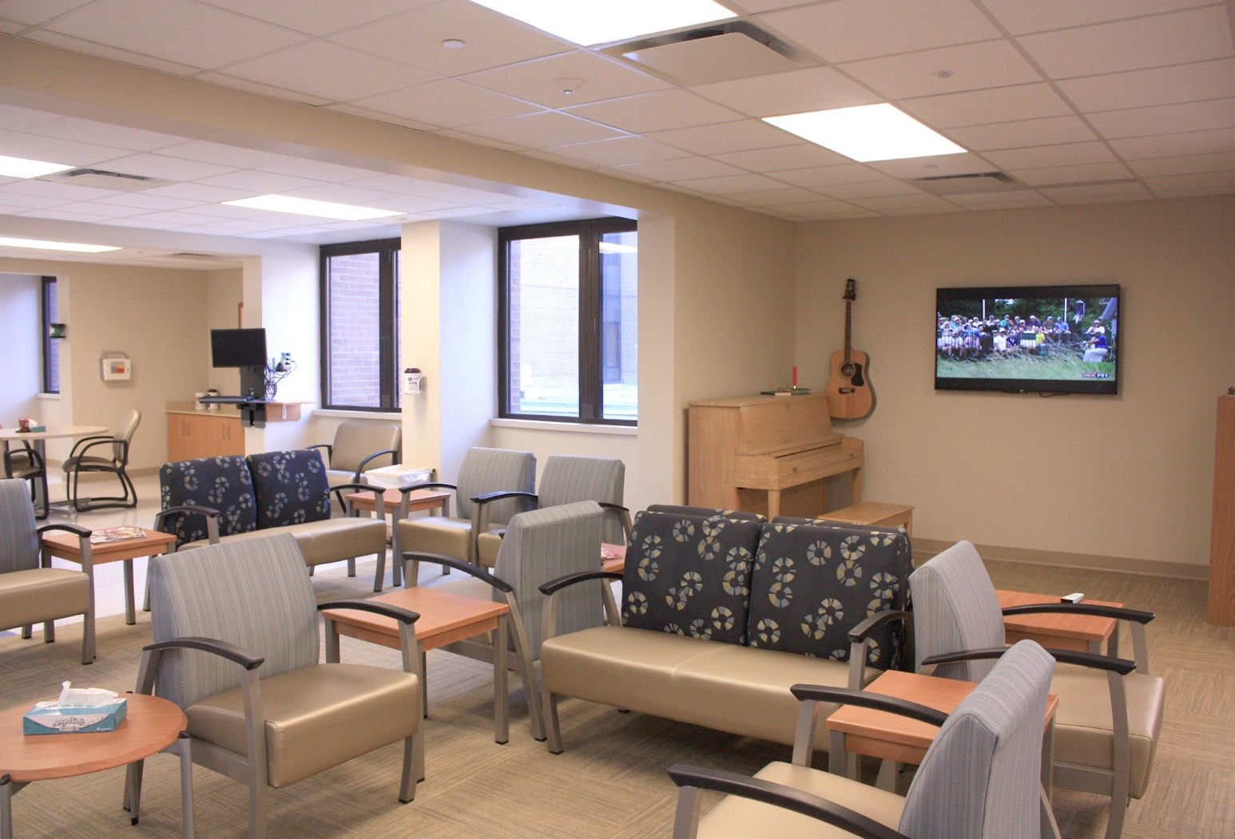
Dining and Social Spaces
Our dining and social space is comfortable and spacious, with different activities such as music, TV and games available to patients and their families.
Image Here – Remove box and replace with image

Slide 5
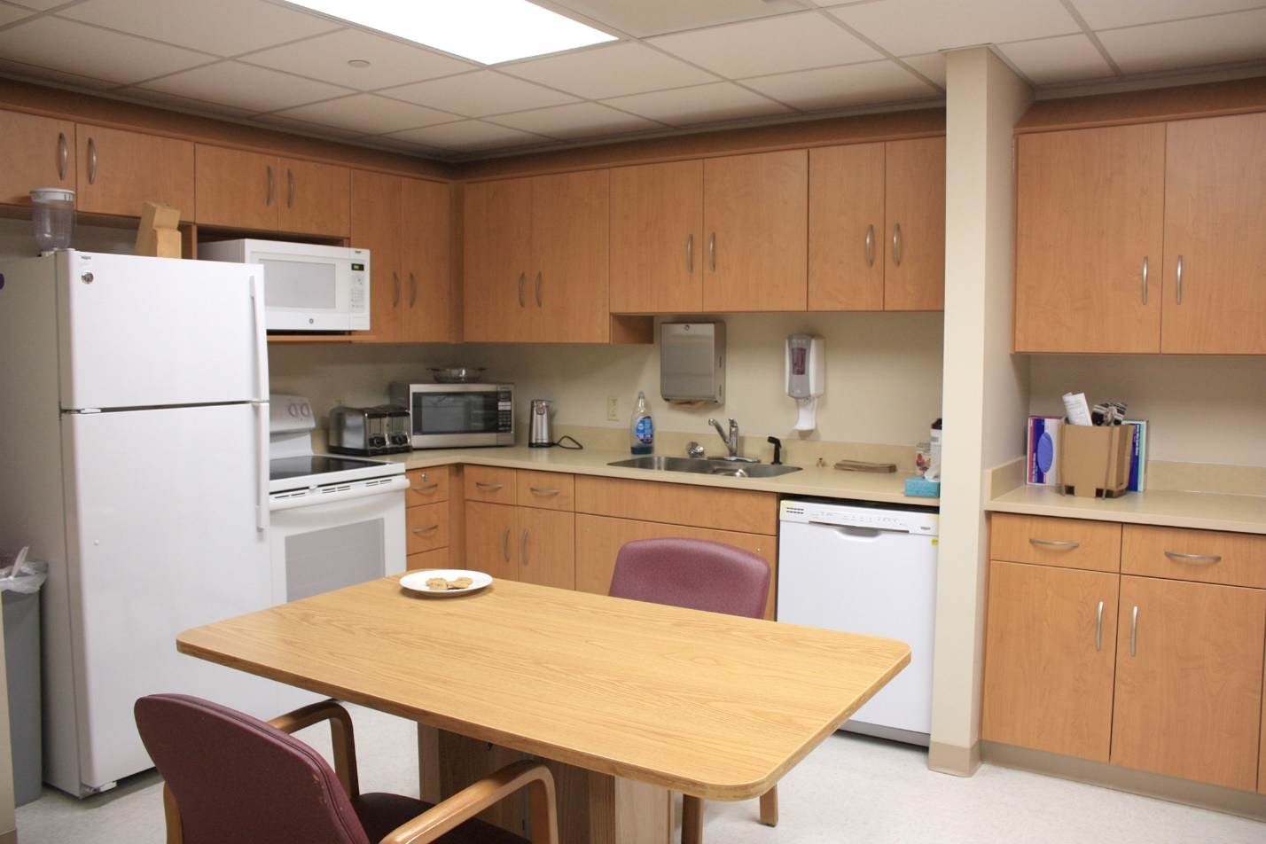
We have a fully functioning kitchen and laundry area to aid our therapists in occupational therapy.
Our staff of therapists and nurses are diligent and helpful in their constant care and assistance throughout the patient’s stay.

Slide 6
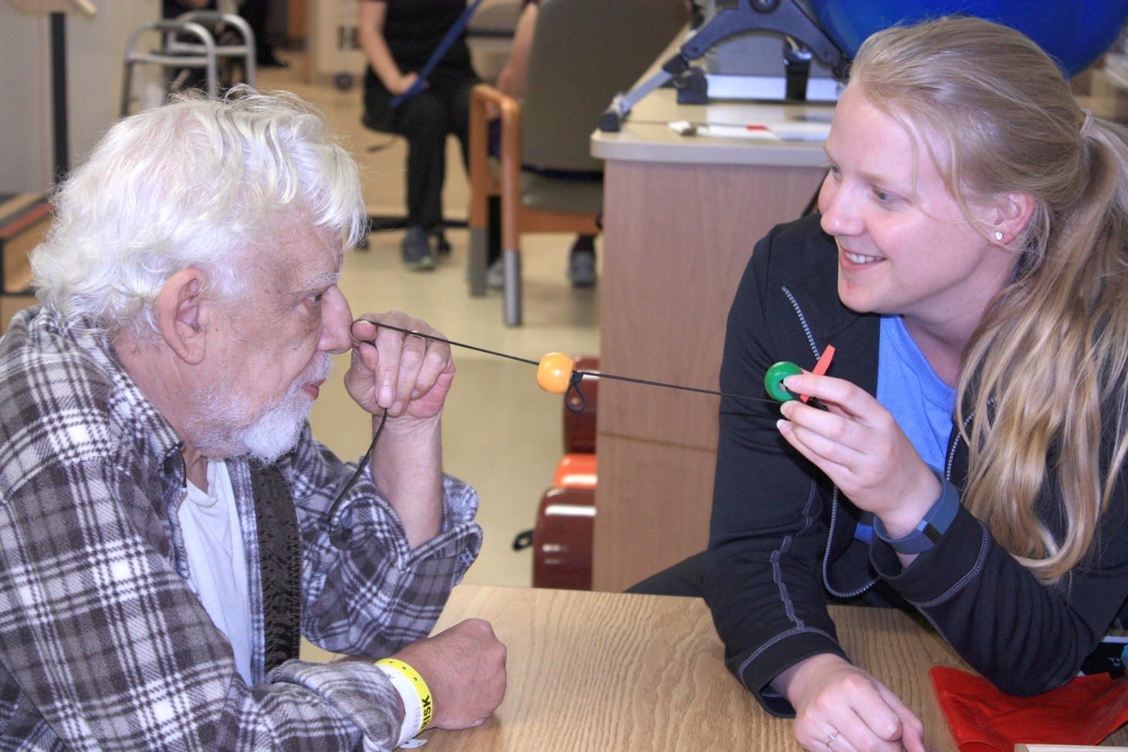
Vision Therapy
Our rehabilitation center offers vision therapy, which helps patients with a variety of different conditions, including:
• Brain injury and stroke
• Macular degeneration, glaucoma,
diabetic retinopathy and cataracts
• Pre-driving assessment
• Outpatient treatments for children
• Eye movement therapy
Image Here – Remove box and replace with image

Slide 7
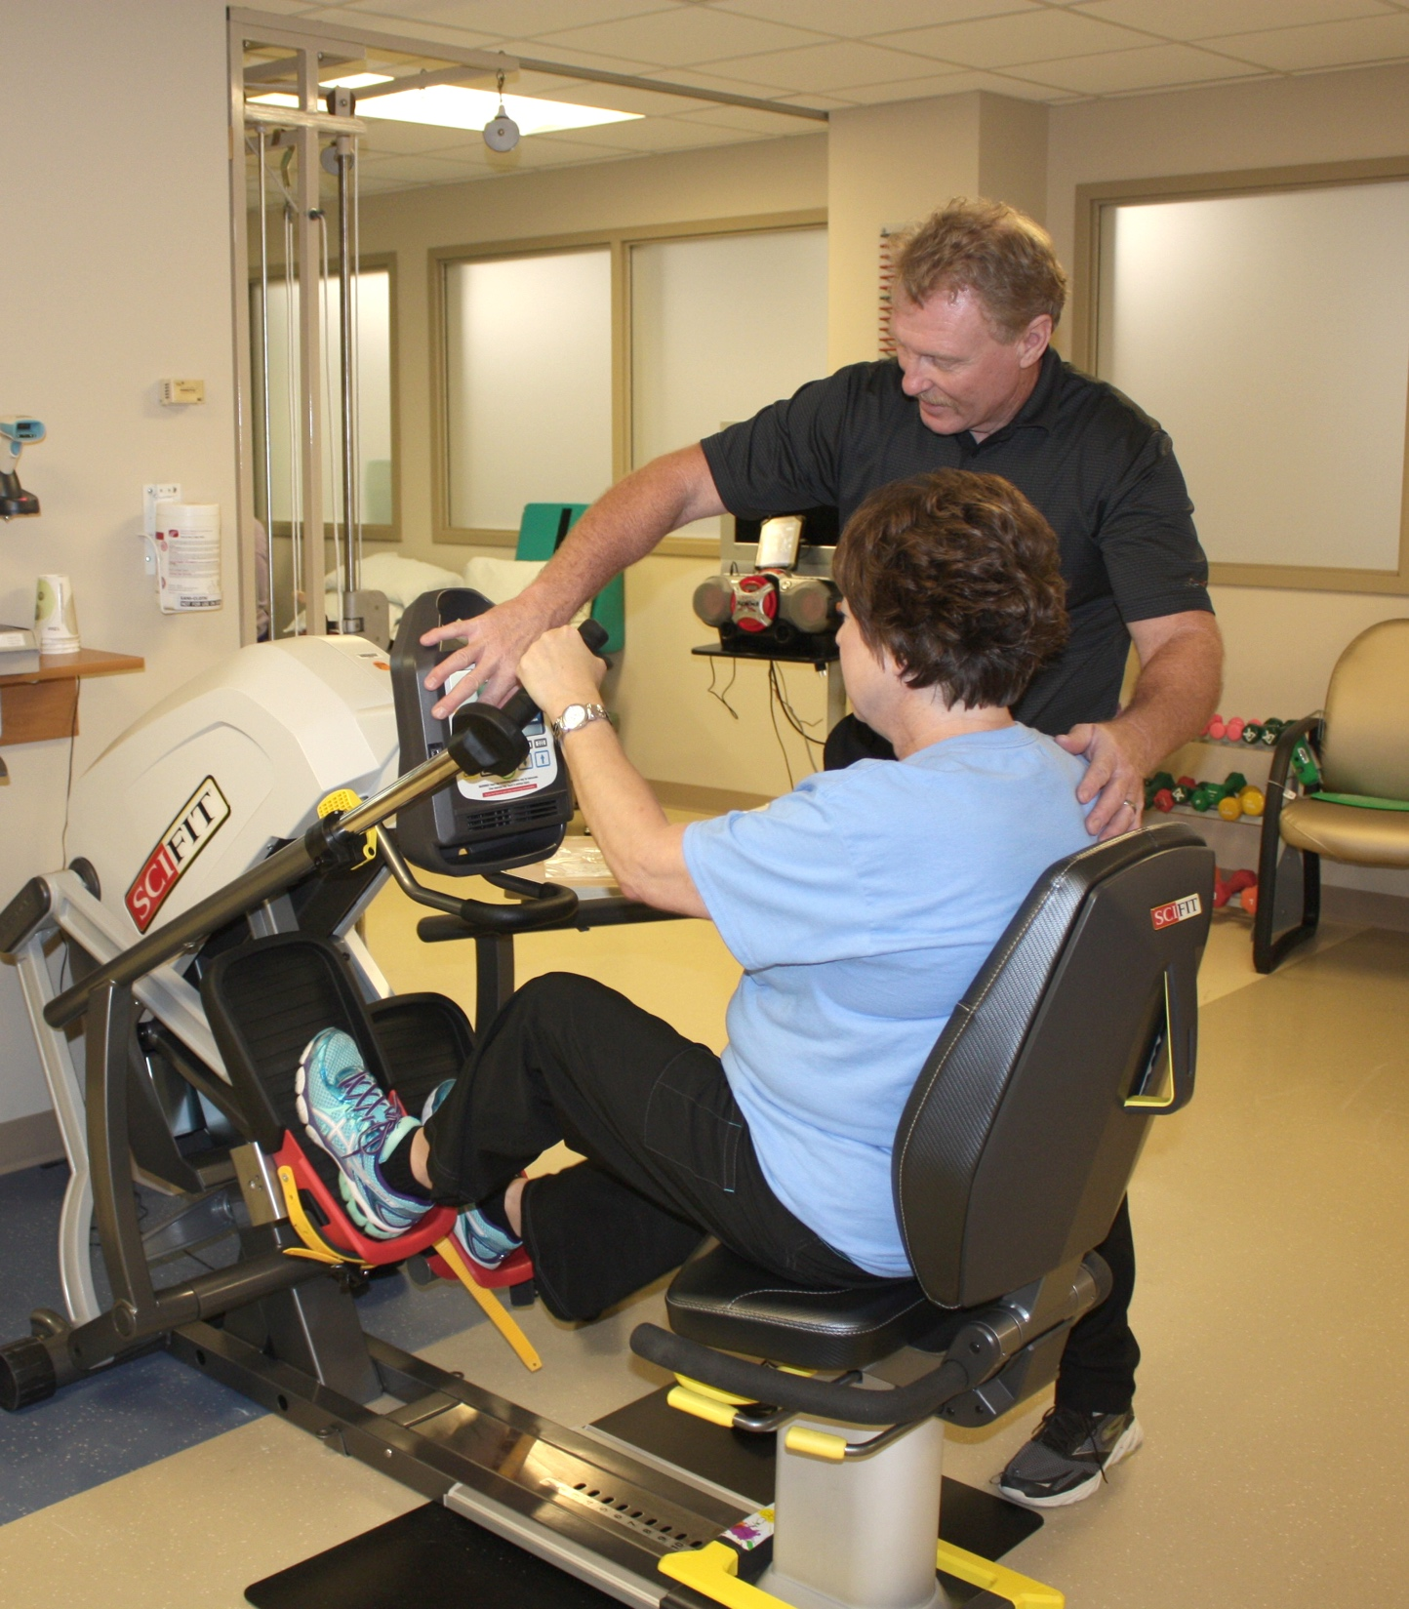
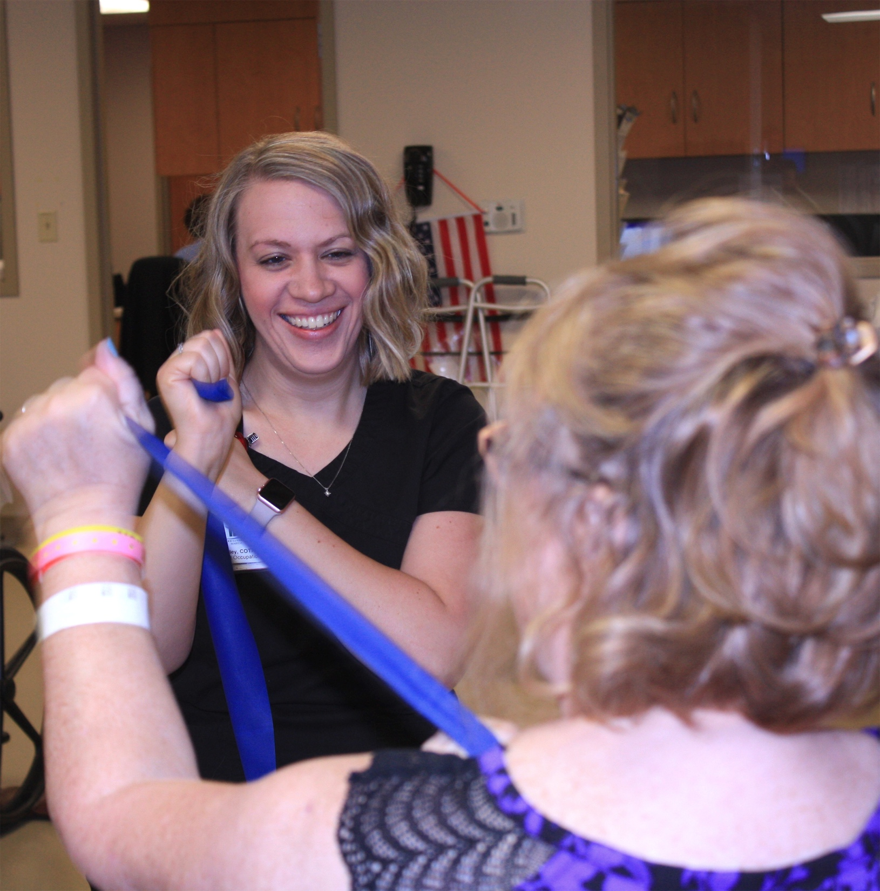
Image Here – Remove box and replace with image

Slide 8
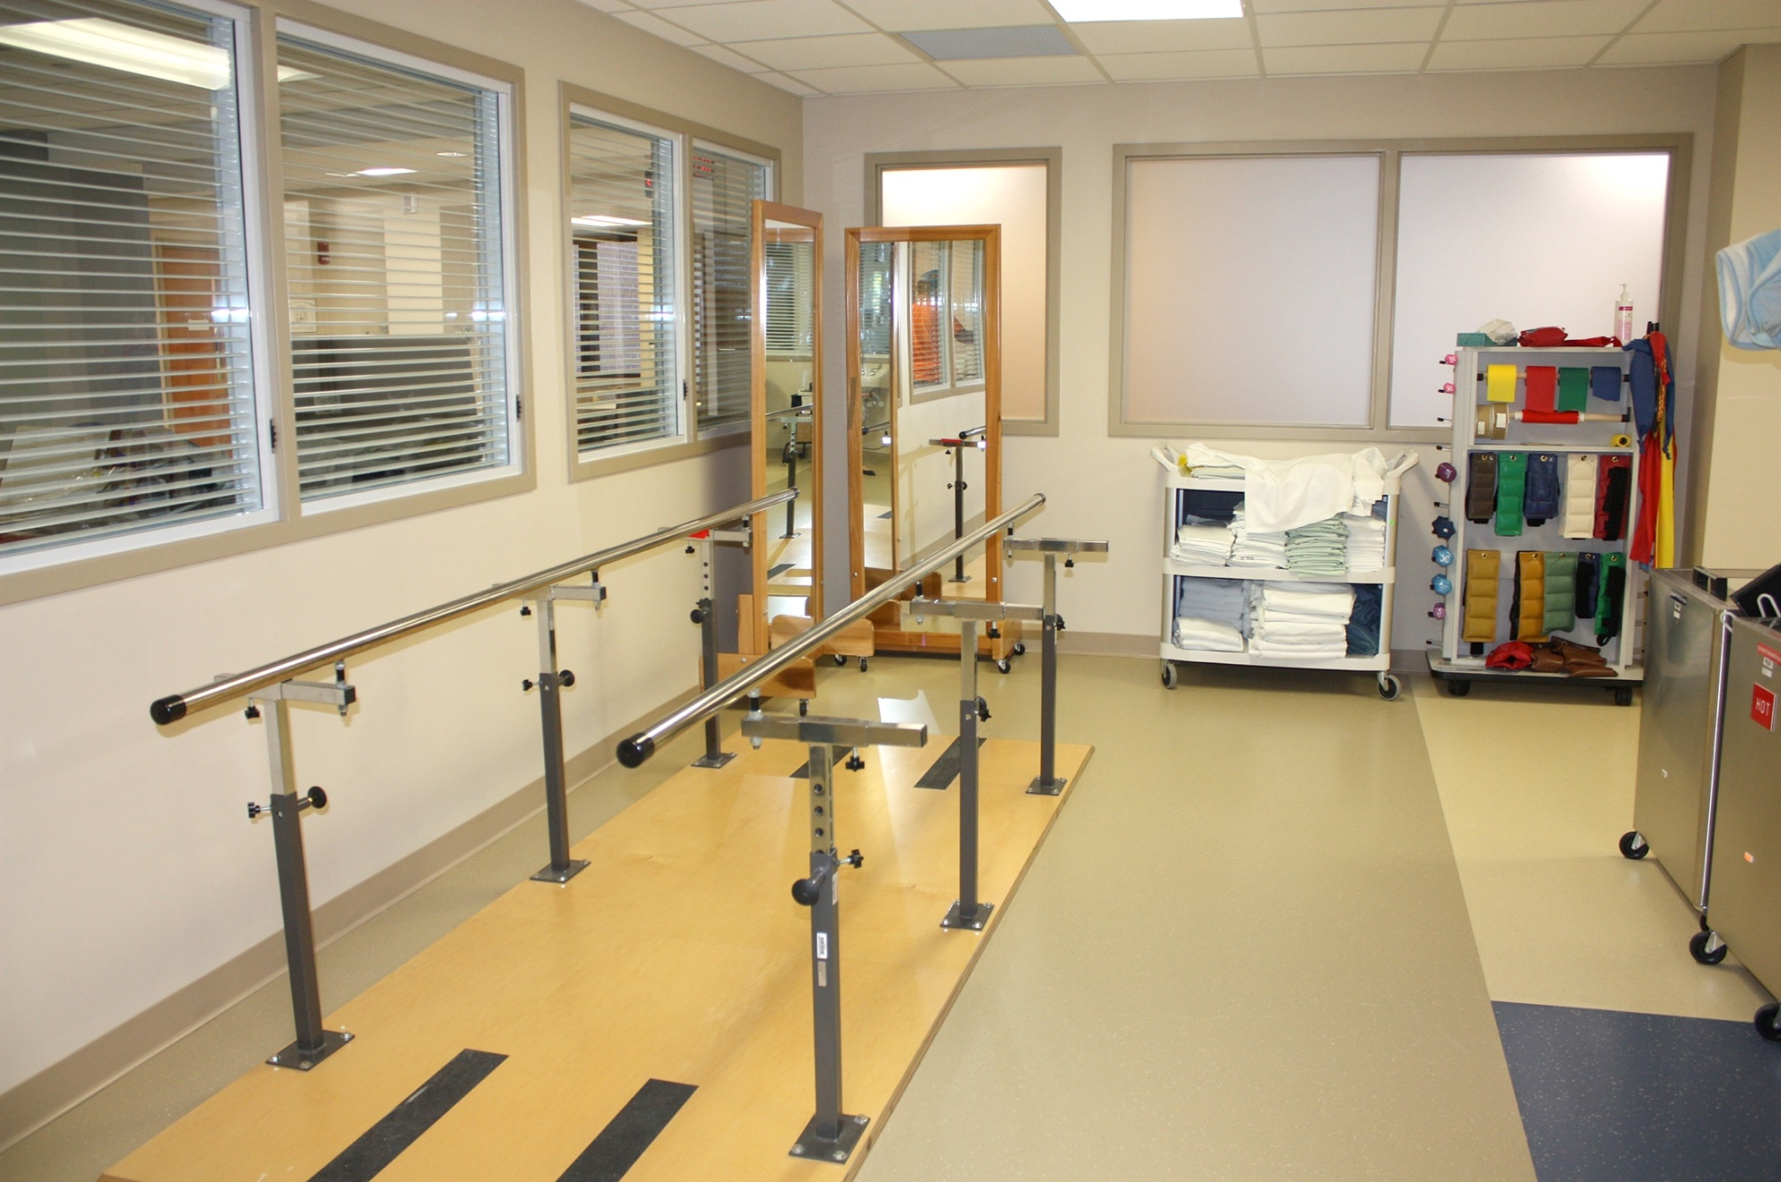
Gym
Our new gym has a multitude of instruments to help our patients recover.

Slide 9
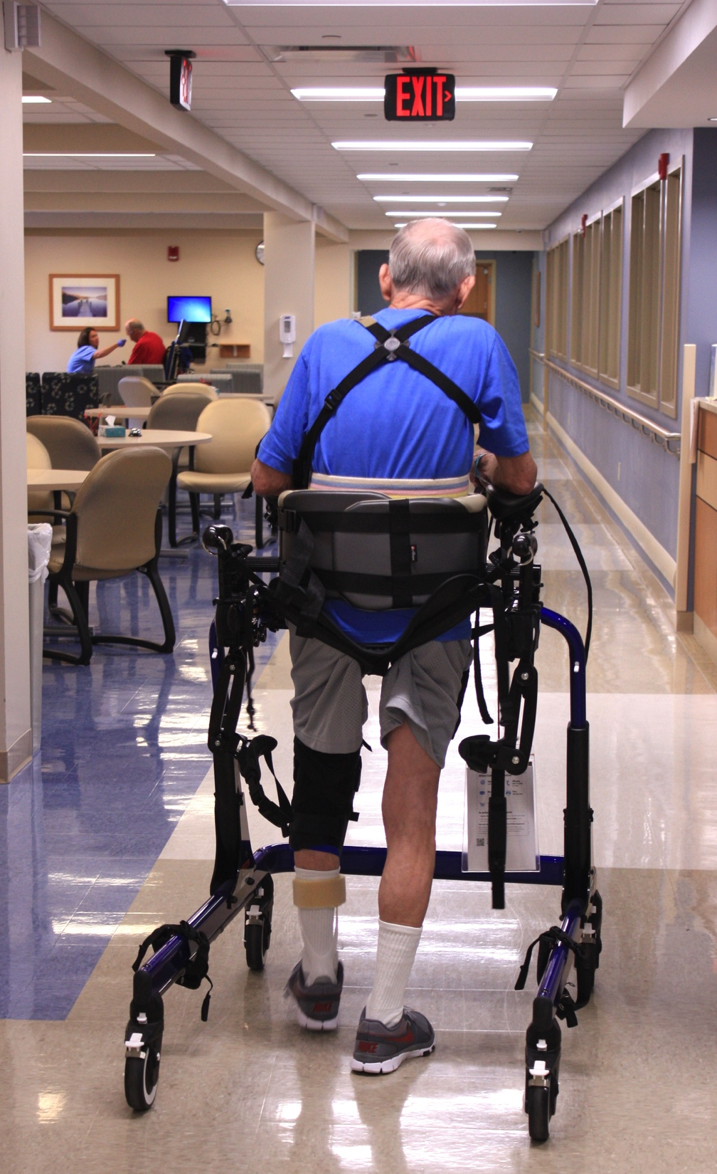
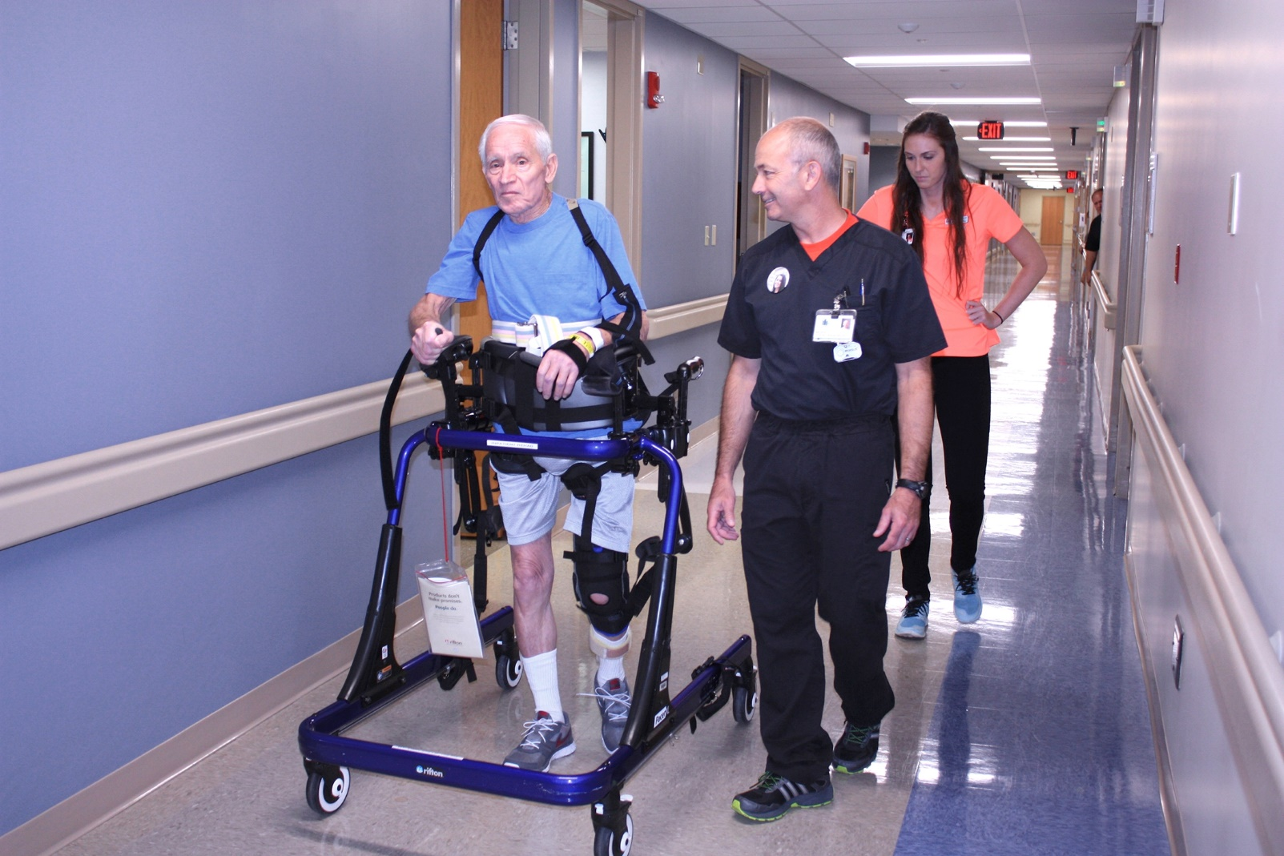
Our dedication to patient care and our state-of-the-art technology will have you back on your feet in no time.

Slide 10
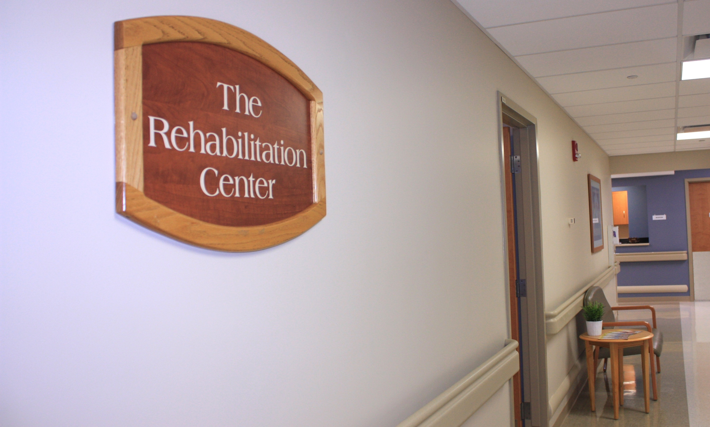
Admission: Please contact the Good Samaritan Rehabilitation Center at 812-885-3601 for additional information.

